Slide 1
INST314 – Final Project
Asad Raheem

Slide 2
Subject of interest | Happiness in marriage and what can contribute to that. This interests me because the divorce rate is so high and there are so many factors that could contribute to a happy marriage that it remains unclear what works and what does not.
Data sources | https://gssdataexplorer.norc.org/projects/91995/extracts
3 research questions
 | 1. Does economic status have an impact on the feeling of happiness in marriage?
 | 2. Is there a noticable effect of having children and the number of children on the feeling of happiness in marriage?
 | 3. Do some age groups have a higher feeling of happiness in marriage than others?

Slide 3
1. A general introduction | There is so much unknown about the concept of marriage and what makes it work and what stressors can actually have an impact on it working or being satisfying.
2. A problem that arises from this state of affairs. | The rate of divorce is rising greatly and there are so many people unhappy in their marriages that may not know what factors are contributing to it.
3. A solution which might arise from your research. | This research could help people identify reasons or factors that are contributing to their unhappiness and then focus on addressing those things, with the hope of increasing happiness in marriage.
4. A sentence which encapsulates your area of research. | This research will look at the idea of happiness in marriage as it relates to several key factors of people’s lives, such as household income or the number of children they have.
5. A description of your method, part 1. | We began by sourcing existing data to build a database that consists of user responses to a number of key questions that outlines their age, number of children, happiness in marriage, and other variables.
6. Method pt. 2. | We then utilized this database to create descriptive statistics to highlight aspects our sample and the associated data.
7. Method pt. 3. | We performed a number of statistical tests to address three specific hypotheses and then interpreted our results.
8. Summary of conclusions, | We found that there was some correlation, specifically between total household income and number of children and happiness in marriage, but failed to prove many of our other claims.
9. Statement of limits and next steps. | The data limited us, in that it was only for certain years, and there is a limit to the number of tests we performed as it is possible that the results would be different if looking at the sample more closely in terms of specific variables and then performing analyses many times, but ultimately the next steps would involve further investigation of what we found with the introduction of other variables that could affect happiness in marriage.

Slide 4
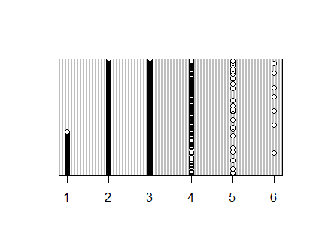
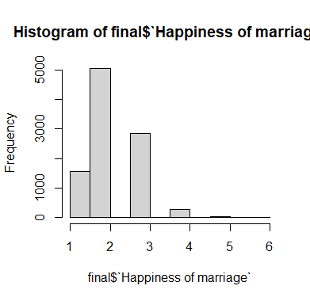
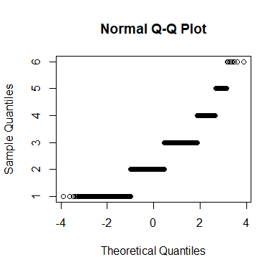
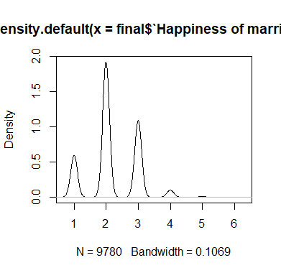

Slide 5
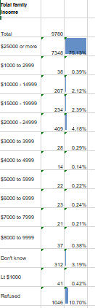
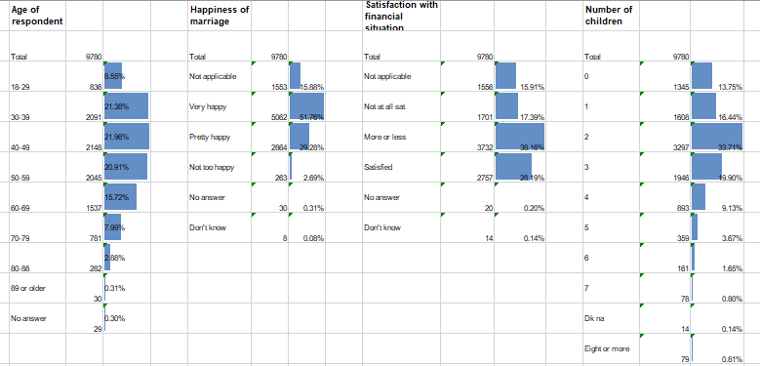

Slide 6
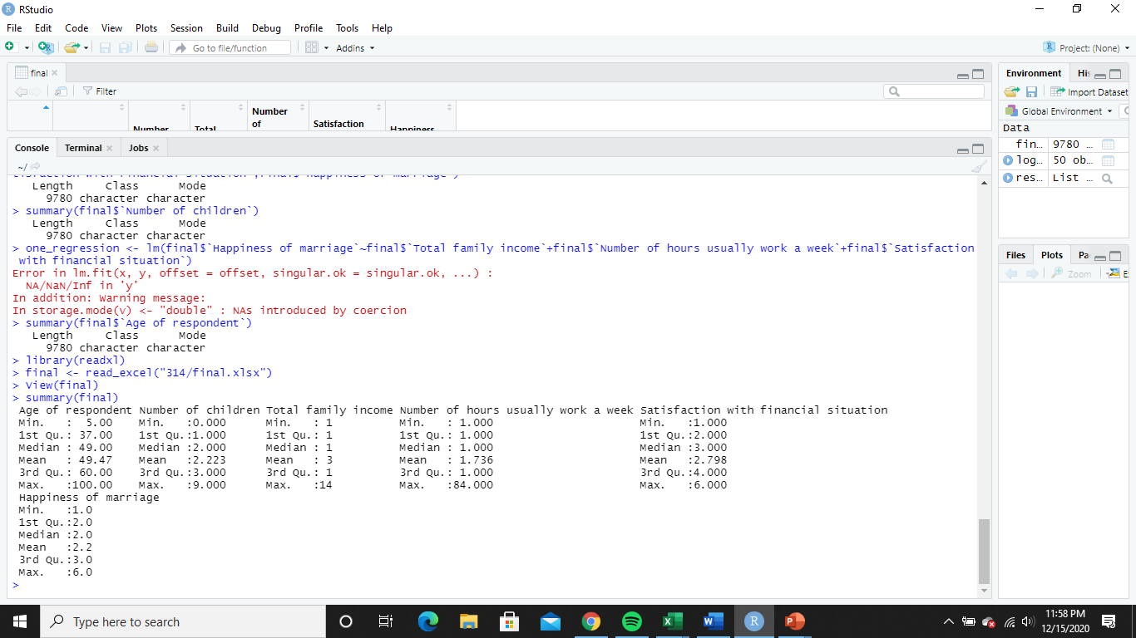
Total family income | Cod | Happiness of marriage | Code | Satisfaction with financial situation | Code | Number of children | Code | Age of respondent | Code
$25000 or more | 1 | Not applicable | 1 | Not applicable | 1 | 0 | 0 | 89 or older | 100
$1000 to 2999 | 2 | Very happy | 2 | Not at all sat | 2 | 1 | 1 | No answer | 101
$10000 - 14999 | 3 | Pretty happy | 3 | More or less | 3 | 2 | 2
$15000 - 19999 | 4 | Not too happy | 4 | Satisfied | 4 | 3 | 3
$20000 - 24999 | 5 | No answer | 5 | No answer | 5 | 4 | 4
$3000 to 3999 | 6 | Don't know | 6 | Don't know | 6 | 5 | 5
$4000 to 4999 | 7 |  |  |  |  | 6 | 6
$5000 to 5999 | 8 |  |  |  |  | 7 | 7
$6000 to 6999 | 9 |  |  |  |  | Dk na | 8
$7000 to 7999 | 10 |  |  |  |  | Eight or more | 9
$8000 to 9999 | 11
Don't know | 12
Lt $1000 | 13
Refused | 14

Slide 7
Research question | 1. Does economic status have an impact on the feeling of happiness in marriage?
Hypothesis
The mean happiness in marriage will not be different between total household income, satisfaction with financial situation, and number of hours usually work. | Mean happiness in marriage( income)=mean happiness in marriage(satisfaction)=mean happiness in marriage(hours)
The mean happiness in marriage will be different between total household income, satisfaction with financial situation, and number of hours usually work. | Mean happiness in marriage( income) /=mean happiness in marriage(satisfaction) /=mean happiness in marriage(hours)
There is no association between happiness in marriage and total household income | Happiness in marriage no relation total household income
There is an association between happiness in marriage and total household income | Happiness in marriage = total household income +etc
Total household income, satisfaction with financial situation, and number of hours usually worked will not be predictor variables for happiness in marriage. | Total household income, satisfaction with financial situation, and number of hours usually worked /= happiness in marriage
Total household income, satisfaction with financial situation, and number of hours usually worked will be predictor variables for happiness in marriage. | Total household income, satisfaction with financial situation, and number of hours usually worked = happiness in marriage
Happiness of marriage | A. Taking things all together, how would you describe your marriage? Would you say that your marriage is very happy, pretty happy, or not too happy?
Satisfaction with financial situation | A. We are interested in how people are getting along financially these days. So far as you and your family are concerned, would you say that you are pretty well satisfied with your present financial situation, more or less satisfied, or not satisfied at all?
Total family income, Number of hours usually work | In which of these groups did your total family income, from all sources, fall last year before taxes, that is? Just tell me the letter.

Slide 8
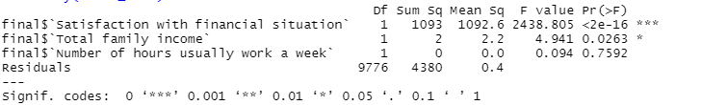
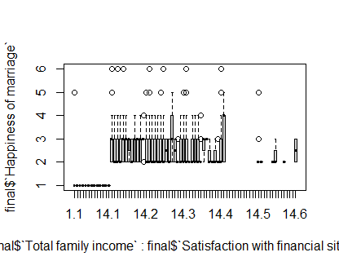
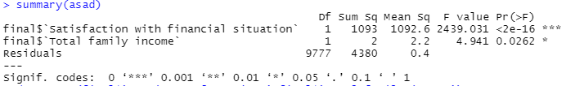
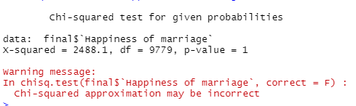
Analysis | ANOVA, chi square test, logit regression, scatterplot matrix

Slide 9
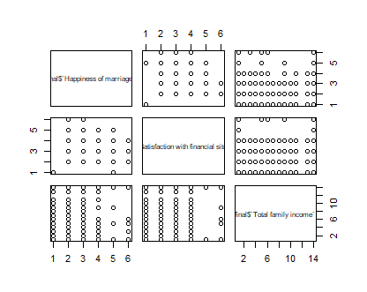
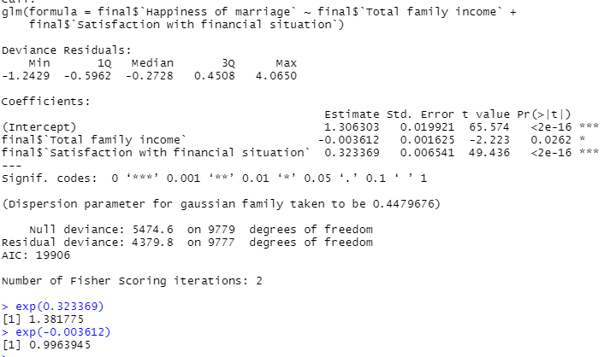
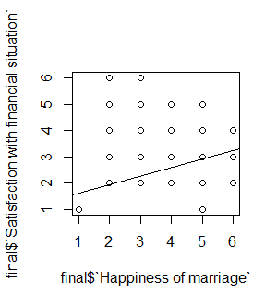
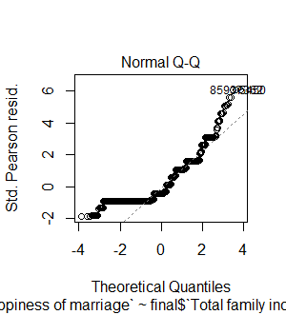

Slide 10
-After performing ANOVA with all three results and then with just total household income and satisfaction with financial situation found that total household income was a statistically significant variable. Chi squared test produced a p value of 1 which is extremely rare, and indicates that this test may not have been appropriate here. Performing a logit regression with just total household income and satisfaction with financial situation indicated that this are slightly important in predicting happiness in marriage. For every increase in total household income there is a 1.00 increase in happiness in marriage, and for every increase in satisfaction with financial situation there is a 1.38 increase in happiness in marriage.
Reject the null hypothesis as the p value of total household income of 0.02 is less than then 0.05 Fail to reject the null hypothesis as the chi square test proved unsuccessful. Reject the null hypothesis as the odds ratio is =>1
ANOVA results indicate that total household income and satisfaction with financial situation have an impact on happiness in marriage, while the chi square results should be discarded as a p value of 1 is very high, and the odds ratio produced from the logit regression indicate that the two variables and their relationship with happiness in marriage is slight.

Slide 11
Research question | 2. Is there an effect on having children and the number of children on the happiness of marriage?
There will be a statistically significant difference in the means of happiness in marriage for people with 0 kids vs 3 kids | Mean happiness in marriage for those with 0 kids = Mean happiness in marriage for those with 3 kid
There will not be a statistically significant difference in the means of happiness in marriage for people with 0 kids vs 3 kids | Mean happiness in marriage for those with 0 kids /= Mean happiness in marriage for those with 3 kid
Number of children will be the explanation for the difference in mean scores of happiness in marriage between those that have 0 kids and those that have 3 kids | Difference in mean scores = number of children + other factors
Number of children will not be the explanation for the difference in mean scores of happiness in marriage between those that have 0 kids and those that have 3 kids | Difference in mean scores /= number of children + other factors
There will be a statistically significant difference in the variance of happiness in marriage between those that had 0 kids and those that had 3 kids | Variance of happiness in marriage for those with 0 kids <>= Variance of happiness in marriage for those with 3 kids
There will not be a statistically significant difference in the variance of happiness in marriage between those that had 0 kids and those that had 3 kids | Variance of happiness in marriage for those with 0 kids <>/= Variance of happiness in marriage for those with 3 kids
Happiness of marriage | A. Taking things all together, how would you describe your marriage? Would you say that your marriage is very happy, pretty happy, or not too happy?
Number of children | How many children have you ever had? Please count all that were born alive at any time (including any you had from a previous marriage).

Slide 12
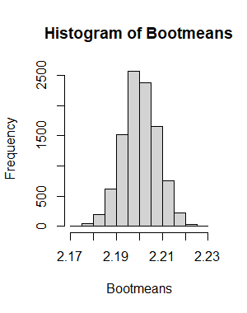
Analysis | T test, F test, Bootstrap analysis
F-Test Two-Sample for Variances
 | 0 kids | 3 kids
Mean | 2.1829 | 2.225590956
Variance | 0.600451 | 0.544969445
Observations | 1345 | 1946
df | 1344 | 1945
F | 1.101807
P(F<=f) one-tail | 0.026139
F Critical one-tail | 1.085647
 | t test 0 kids vs 3 kids
p value | 0.113328986
P value for difference in means = 0.4767

Slide 13
-Expected to find a statistically significant difference between the means between those that had 0 kids and those that had 3 kids but found no evidence to support this. -Expected to find support that number of children would be the explanation for difference in happiness in marriage but did not find statistically significant evidence that supports this. - Expected to find evidence that number of children explained the variance in happiness in marriage but did not find statistically significant results to support this.
-Fail to reject the null hypothesis as the t test p value of 0.11 is larger than the critical value of 0.05. -Fail to reject the null hypothesis as the p value for difference in means = 0.4767 which is >0.05. -Fail to reject the null hypothesis as the F value of 1.101 is greater than the critical F value of 1.08.
To explore the question surrounding the relationship between number of children and happiness of marriage, a number of tests were performed (T test, F test, and bootstrap analysis) that produced results that were not statistically significant which made it so we failed to reject all null hypotheses. However there is potential room for further exploration as the F value of 1.101 was fairly close to the critical F value of 1.08

Slide 14
Research question | Is there a difference in a happiness in marriage as you age?
Hypotheses
There is a non-zero correlation between age and happiness in marriage | Equation
There is not a non-zero correlation between age and happiness in marriage | Equation
There is a statistically significant difference in the means of happiness in marriage amongst 25 year olds and 60 year olds. | Means of happiness in marriage 25 year olds <>/= Means of happiness in marriage 60 year olds
There is not a statistically significant difference in the means of happiness in marriage amongst 25 year olds and 60 year olds. | Means of happiness in marriage 25 year olds = Means of happiness in marriage 60 year olds
While controlling for other factors, such as household income or number of children, age of respondent will be a statistically significant predictor of happiness in marriage. | Happiness in marriage = age of respondent + other factors
While controlling for other factors, such as household income or number of children, age of respondent will not be a statistically significant predictor of happiness in marriage. | Happiness in marriage /= age of respondent + other factors
Age | Age of respondent
Happiness of marriage | A. Taking things all together, how would you describe your marriage? Would you say that your marriage is very happy, pretty happy, or not too happy?
Analysis | Correlation matrix and t test

Slide 15
 | T test 24 years vs 60 years
p value | 0.096475233
 | Age of respondent | Number of children | Total family income | Number of hours usually work a week | Satisfaction with financial situation | Happiness of marriage
Age of respondent | 1
Number of children | 0.268831018 | 1
Total family income | 0.086880195 | 0.042989351 | 1
Number of hours usually work a week | -0.03160161 | -0.001022471 | -0.01720251 | 1
Satisfaction with financial situation | 0.126842632 | -0.024539549 | 0.043266459 | -0.01858307 | 1
Happiness of marriage | 0.02831519 | 0.050173953 | -0.000760433 | -0.00519924 | 0.446740947 | 1

Slide 16
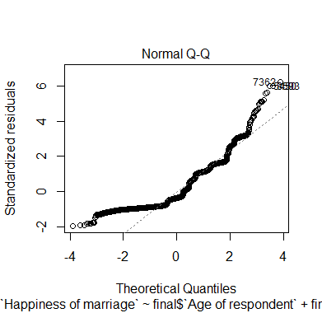
Call:
lm(formula = final$`Happiness of marriage` ~ final$`Age of respondent` +
final$`Number of children` + final$`Total family income` +
final$`Number of hours usually work a week` + final$`Satisfaction with financial situation`)
Residuals:
Min 1Q Median 3Q Max
-1.3153 -0.5661 -0.2505 0.4969 4.1529
Coefficients:
Estimate Std. Error t value Pr(>|t|)
(Intercept) 1.3249849 0.0281793 47.020 < 2e-16 ***
final$`Age of respondent` -0.0023211 0.0004592 -5.054 4.40e-07 ***
final$`Number of children` 0.0357420 0.0044651 8.005 1.33e-15 ***
final$`Total family income` -0.0035007 0.0016250 -2.154 0.0312 *
final$`Number of hours usually work a week` 0.0002014 0.0012168 0.166 0.8685
final$`Satisfaction with financial situation` 0.3290908 0.0065815 50.002 < 2e-16 ***
---
Signif. codes: 0 ‘***’ 0.001 ‘**’ 0.01 ‘*’ 0.05 ‘.’ 0.1 ‘ ’ 1
Residual standard error: 0.6669 on 9774 degrees of freedom
Multiple R-squared: 0.2059, Adjusted R-squared: 0.2055
F-statistic: 506.9 on 5 and 9774 DF, p-value: < 2.2e-16

Slide 17
Results | Expected to find a non zero correlation between age and happiness in marriage. Found a correlation, but not one of statistical significance. There is no statistically significant difference in the means of happiness in marriage at 25 years and 60 years. While the results of the regression appear to be statistically significant the model has little explanatory power, therefore it does not appear that age is a statistically significant predictor of happiness in marriage.
Reject or fail to reject the null | -Fail to reject the null hypothesis that there is a statistically significant correlation between age and happiness in marriage - Fail to reject the null as the p value of 0.096 from the t test is much larger than the critical p value of 0.05 -Fail to reject the null hypothesis that age is a significant predictor of happiness in marriage
Explanation | After several tests and measures we found no statistically significant results to support the claim that there is a difference in happiness in marriage between age groups or that there is a significant correlation between the two.

